Slide 1
Python Deeper Dive
Lesson 3.3
Notes:
1.1

Slide 2

Class Objectives
By the end of today’s class you will be able to:
Add, commit, and push code up to GitHub from the command line.
Create and use Python dictionaries.
Read data in from a dictionary.
Use list comprehensions.
Write and re use Python function.
Have a firm understanding of coding logic and reasoning.
Notes:
1.1

Slide 3




Bem vindos
ようこそ
Welcome
...that’s our menu
for today’s class
topped with
command line…
cd
ls
la
../
Notes:
1.1
Welcome students to class and let them know today's class will dive deeper into more of Python's capabilities. Today's class will also finish with more usage of Git and Github, particularly how to use the command line to add and commit files.
NOTE: Welcome in 3 languages. Portuguese, Japanese and English
Note:: Python logo grabbed from 22-1 slide 33, GitHub Logo grabbed from ‘Supplementary GitHub’ module 20: Final Project, Git logo grabbed from module 3 Folder images. (double check w/ Joe)

Slide 4
Activity: Cereal Cleaner
In this activity, you will be creating an application that reads in cereal data from CSV and then prints only those cereals that have more than 5 grams of fiber in them.
20 Minutes
Notes:
1.2

Slide 5

Activity: Cereal Cleaner
Instructions:
Read through cereal.csv and find the cereals that contain five grams of fiber or more, printing the data from those rows to the terminal.
Hint:
Every value within the csv is stored as a string and certain values have a decimal. This means that they will have to be cast to be used.
csv.reader begins reading the csv file at the first row. Explain that next(csv_reader, None) will skip the header row.
Integers are whole numbers and, as such, cannot contain decimals. Decimal numbers will have to be cast as a float or double.
Bonus:
Try the following again but this time using cereal_bonus, which does not includes a header.

Slide 6
Notes:
1.3
Check lesson plan as the review is now an Everyone Do Activity!
OR
Open cereal_solved.py (code below) and walk through the code with the class, answering whatever questions students have.
import os
import csv
cereal_csv = os.path.join("..", "Resources", "cereal.csv")
# Open and read csv
with open(cereal_csv) as csvfile:
csvreader = csv.reader(csvfile, delimiter=",")
# Read the header row first (skip this part if there is no header)
csv_header = next(csvfile)
print(f"Header: {csv_header}")
# Read through each row of data after the header
for row in csvreader:
# Convert row to float and compare to grams of fiber
if float(row[7]) >= 5:
print(row)

Slide 7
Dictionaries
Notes:
2.1
When you hit slide 10 open up dictionaries.py and explain what you are going to do.

Slide 8


Another data type that is commonly used in Python is the dictionary, or ‘dict’.
Notes:
2.1
Note: background slide from ‘data-03-3-python-deeper-dive’ slide 6, and Einstein from ‘SQLAlchemy Daya 3’ slide 8

Slide 9

Dictionaries
A dictionary is an object that stores a collection of data.
Like lists and tuples, dictionaries can contain multiple values and data types within them.
Unlike lists and tuples, however, dictionaries store data in key-value pairs. The key in a dictionary is a string that can be referenced in order to collect the value it is associated with.
Very similar to a dictionary that contains definitions, the words in the dictionary would be considered the keys, and the definitions of those words would be the values.
Notes:
2.1

Slide 10


Let’s
code...
Notes:
2.1
Open up dictionaries.py and explain the code that is contained within while switching slides!

Slide 11
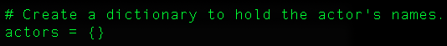
Dictionaries
To initialize or create an empty dictionary we use the following syntax, actors ={}.
Or, you can create a dictionary with the built-in Python dict() function, actors = dict().
Notes:
2.1
Open up dictionaries.py and explain the code that is contained within.

Slide 12
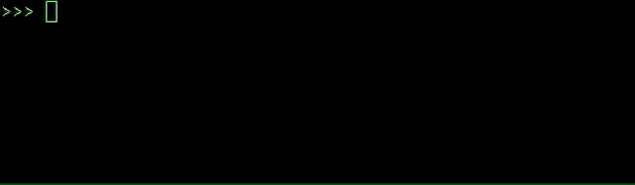
Dictionaries
Values can be added to dictionaries at declaration by creating a key that is stored within a string, following it with a colon, and then placing the value desired afterwards.
Referencing a value within a dictionary is as simple as calling the dictionary and following it up with a pair of brackets containing the key for the value desired.
Notes:
2.1
Open up dictionaries.py and explain the code that is contained within.

Slide 13
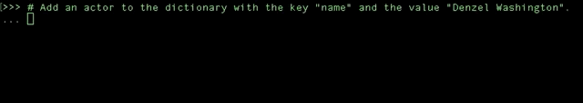
Dictionaries
Values can also be added to dictionaries by placing the key within single or double quotes inside brackets, and then assigning the key a value, and values can be changed or overwritten by assigning the key a new value.
Notes:
2.1
Open up dictionaries.py and explain the code that is contained within.

Slide 14
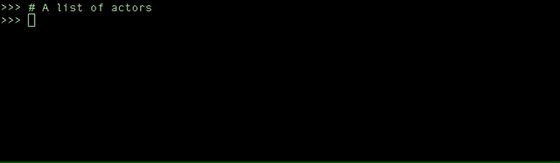
Dictionaries
Dictionaries can hold multiple pieces of information by following up each key-value pairing with a comma and then placing another key-value pair afterwards.
Keys are immutable objects, like integers, floating-point decimals, or strings. Keys cannot be lists or any other type of mutable object.
Values in a dictionary can be objects of any type: integers, floating-point decimals, strings, Boolean values, datetime values, and lists.
Notes:
2.1
Open up dictionaries.py and explain the code that is contained within.

Slide 15
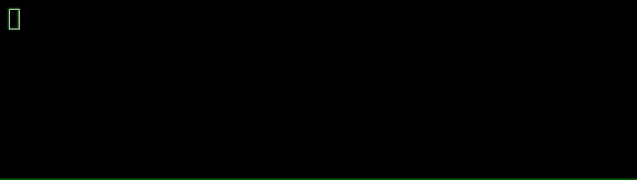
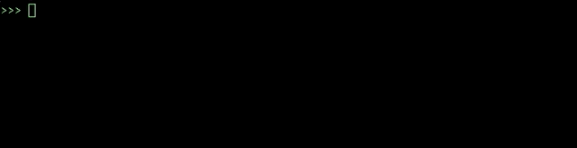
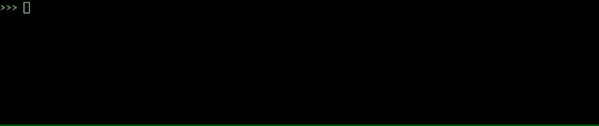
Dictionaries
Dictionaries can also contain other dictionaries. In order to access the values inside nested dictionaries, simply add another key to the reference.
Notes:
2.1
Open up dictionaries.py and explain the code that is contained within.

Slide 16
Activity: Hobby-Book
In this activity, you will be creating and accessing yours own dictionaries based upon your hobbies.
10 Minutes
Notes:
2.2
Open up 03-HobbyBook within the terminal and run the code to show the end results of the application.

Slide 17
Activity: Hobby-Book
Instructions:
Create a dictionary that will store the following:
Your name
Your age
A list of a few of your hobbies
A dictionary of a few days and the time you wake up on those days
Print out your name, how many hobbies you have and a time you get up during the week.
Notes:
2.2

Slide 18
Notes:
2.3
Check lesson plan to review! Or see below:
Open up 03-HobbyBook and walk through the code, making sure to explain the following:
A variable called my_info stores the primary dictionary as noted by the curly braces.
The keys are "name", "occupation", "age", "hobbies" and "wake-up". Their values are what is stored after the colons with each new key-value pair being separated by a comma.
In order to find the number of values stored within the "hobbies" key, the len() function is used.

Slide 19
List Comprehensions
Notes:
3.1

Slide 20
Get ready
for
some live coding...
Notes:
3.1
Open comprehensions.py and live code. Walk through the different aspects of the code. (leave this slide while you live code) in case you have only one projector (TV, display, projector) show your live code instead.
Explain the example with the fish variable.
Explain that we can treat fish like an array, and use a list comprehension to turn it into a list of its constituent letters.
Explain that we can then use this list of letters to create a new list of capitalized letters, by using a comprehension and calling upper on each letter.
Finally, step through the temperature example.
Explain that we can filter data in addition to changing it.
Explain how adding conditional logic, such as if statements, to a list comprehension allows us to select a certain value or range of values.
Emphasize that this example is just intended to expose students to the flexibility and power of list comprehensions.
Take a moment to answer any remaining questions before slacking out the example files.

Slide 21
Activity: List Comprehensions
In this activity, you will use list comprehensions to compose a wedding invitation to send to every name on your mailing list.
10 Minutes
Notes:
3.2

Slide 22
Activity: List Comprehensions
Instructions:
Open the file called comprehension.py.
Create a list that prompts the user for the names of five people they know.
Run the provided program. Note that nothing forces you to write the name "properly"—e.g., as "Jane" instead of "jAnE". You will use list comprehensions to fix this.
First, use list comprehensions to create a new list that contains the lowercase version of each of the names your user provided.
Then, use list comprehensions to create a new list that contains the capitalize versions of each of the names in your lower-cased list.
Bonus:
Create a thank you note to address to all guests using f-string and print the statement using title() function.
Hints:
See the documentation for the title method.
Notes:
3.2
Slack out title to students!

Slide 23
Notes:
3.3
Check lesson plan to review! Or see below:
Open comprehensions.py.
Explain that the first code block simply declares a list to store names in, and then collects five names from the user.
Ask a student to explain how to generate a list of lower-cased names.
Explain that we can use a list comprehension that calls lower on each name in the list.
Ask a student to explain how to generate a list of title-cased names.
Explain that we can use a list comprehension that calls title on each name in the list.
Ask a student to explain how to build the greeting for each sanitized string.
Explain that we can inject each name in titlecased into a format string.
Explain that, if we wanted to build a more complicated string, we would have to use a function, which we'll cover later in today's lesson.
Finally, explain that we simply use a for loop to print every invitation in the invitations list.
Explain that we use a for loop instead of a list comprehension because we are not using titlecased to create a new list—rather, we are simply performing an action for each item in titlecased.
Take a moment to answer any remaining questions before slacking out the solution and moving on.

Slide 24
Functions
Notes:
4.1

Slide 25
DRY - Don’t Repeat Yourself is a principle of software development to reduce repetition of the written code.
Notes:
Note: background slide from ‘data-03-3-python-deeper-dive’ slide 6, and Einstein from ‘SQLAlchemy Daya 3’ slide 8
4.1
Explain the DRY concept to students and that we use functions and modules to avoid repeating code.
Ask a student (or: the class) if there are any disadvantages to writing code that does the same thing in three different places.
Explain that, if we write the same code in different places, and expect it to behave the same everywhere, we have to update it in several places whenever we make a change.
Point out that this can become unwieldy quickly: In large code-bases, copying code in multiple places would often require us to waste time making the same change in several places, and add the extra overhead of forcing us to keep track of duplicated code.
This is the motivation for the mantra of Don't Repeat Yourself, or DRY.

Slide 26
Get ready
for
some live coding...
Notes:
4.1
Open functions.py and live code. Walk through the different functions examples. (leave this slide while you live code) in case you have only one projector (TV, display) show your live code instead.
Things to note while you live code: (you can go back to the lesson plan or navigate yourself during live code here)
Show the basic anatomy of a function:
def name(parameters):
# code goes here
Return
Explain that we use the keyword def to define a function, that foo is the name of the function, and that the parentheses that follow also indicate that foo is a function. Also bring to your students attention the colon at the end of the line.
Run the function in the console to demonstrate.
Remind students that functions are a way for us to give a name to a set of instructions we want to be able to repeat.
Point out that we use block indentation for the function body.
Point out that we can pass data to functions through parameters and arguments.
Walk through this code:
def show(message):
print(message)
Explain that message is the data that we give the function, with which it does something.
Explain that we first defined the function, but did not run it, in much the same way that having the blueprint of a house is not the same thing as living inside one.
Explain that we actually run the function with the following code:
show("Hello, World!")
Explain that calling a function is a synonym for running it. So when we say we call a function, it simply means that we are running, or executing, it.
Ask a student to articulate the relationship between message (in the function declaration) and "Hello, World!" (in the function call).
Explain that a parameter is the name of a variable in a function while an argument is the value that you pass to the parameter.
Explain that parameters allow us to run that set of instructions on different inputs, which is what allows us to get different outputs.
To carry the recipe analogy further, consider a recipe for quesadillas. Show and demonstrate the make_quesadilla() function in the code. Parts of the recipe are always the same (they are the "function body"), but we can choose to make the recipe with, for instance, either chicken or beef (our "arguments").
Warn students that arguments are positional and position matters! make_quesadilla("sour cream", "beef") will return "Here is a sour cream quesadilla with beef".
Explain that we can make parameters optional if we specify a default parameter. Go over the following code to illustrate this point:
def make_quesadilla(protein, topping="sour cream"):
quesadilla = f"Here is a {protein} quesadilla with {topping}"
print(quesadilla)
Explain that topping="sour cream" makes "sour cream" our default topping. That is, if no topping is specified as an argument when the function is called, the function will supply "sour cream" as the topping. Demonstrate what happens when we call the make_quesadilla function without a topping as an argument, as well as what happens when the function is called with a specific topping argument:
make_quesadilla("chicken")
make_quesadilla("beef", "guacamole")
Explain that we can return data with the return statement:
def square(number):
return number * number
Ask a student to explain the features of this function.
Point out that we often calculate values inside of functions.
Explain that, to get that value back when the function is done, we use the return keyword. In this case, it returns the squared value.
Explain that we can save the returned value. Run, or have a student explain, the following line of code:
squared = square(2)
print(squared)
Explain that we can print the return value of a function also.
print(square(2))
print(square(3))

Slide 27
Activity: Functions
In this activity, you will write a function that returns the arithmetic average for a list of numbers.
10 Minutes
Notes:
4.2

Slide 28
Activity: Functions
Instructions:
Write a function called average that accepts a list of numbers as a single argument.
The function average should return the arithmetic mean (average) for a list of numbers.
Test your function by calling it with different values and printing the results.
Hint
Arithmetic Mean (average)
Notes:
4.2
Before you slack out Arithmetic Mean (Average) instigate students to source for the informations then self. Work on their thought process to solve problems.

Slide 29
Notes:
4.3
Check lesson plan to review! Or see below:
Open Solved/main.py and walk through the solution.
Explain that we define a function called average that accepts a single parameter called numbers.
Point out that we can define variables inside of the function body that are typically only used inside of the function. length = len(numbers)
Explain that we could have created another variable called average and returned that variable, but we can actually just return the results from sum / length.
Explain that sum / length is first evaluated and then that value is returned.
Explain that we want to test our code by calling the function with test data and printing the results.

Slide 30
Activity: Wrestling With Functions
In this activity, you will create a function capable to search through a list of wrestlers to determine their win, loss, and draw percentages.
15 Minutes
Notes:
5.1

Slide 31
Activity: Wrestling With Functions
Instructions:
Analyze the code and CSV provided, looking specifically for what needs to still be added to the application.
Note that header = next(reader) will read the header row from the csv file.
Using the starter code provided, create a function called print_percentages which takes in a parameter called wrestler_data and does the following:
Uses the data stored within wrestler_data to calculate the percentage of matches the wrestler won, lost, and drew over the course of a year.
Prints out the stats for the wrestler to the terminal
Bonus:
Still within the print_percentages() function, create a conditional that checks a wrestler's loss percentage and prints either "Jobber" to the screen if the number was greater than fifty or "Superstar" if the number was less than 50.
Notes:
5.1
Show students how their application should functions!
Slack out 08-Par_WrestlingWithFunctions/wrestling_functions.py
WWE-Data-2016.csv

Slide 32
Notes:
5.2
Check lesson plan to review! Or see below:
Spend only 10 minutes on this activity.
Use the review section as guidance for talking points as you live-code along with the students.
Be sure to take your time and answer all student questions along the way.
Open and slack out the file 08-Par_WrestlingWithFunctions/wrestling_functions.py from the previous activity and go over the code line by line with the class, answering whatever questions they may have.
Key points to cover in this activity:
Looking through the CSV data beforehand was key to figuring out how to calculate the total number of matches wrestled. Doing so would have told students what each index within a row referred to.
Even though row is the variable being passed into the function, wrestler_data is still used within the function itself. The data within row is essentially moved into wrestler_data for usage within the function.

Slide 33

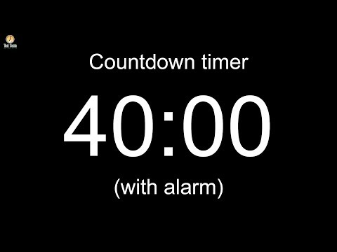
Notes:
Leave slide running during the break!
NOTE : In case needed due to the hour adjustment, fast forward the video timer and start the countdown at 25 minutes!
Image source: AdobeStock_56885471

Slide 34
Intro to Git

Slide 35
Intro to Git
What’s GitHub?
More than 40 million people use GitHub.
It is an essential tool for best code practices.
It is the biggest platform for developers to showcase their work.
Using GitHub makes it easier to collaborate with colleagues and peers and to review previous versions of one’s work.
GitHub is an essential tool for your academic development, and it will transition with you through your professional career.
Think of your knowledge blueprint—it will raise your visibility among potential employers and could translate into a high-paying job.
Notes:
6.1
Explain to students that so far GitHub has really only been used as a sort of drop box to store our files. Although GitHub works well this way, it has far greater capability. Today there will be a deeper dive into what Git is and how to use it through the terminal to interact with Github.

Slide 36
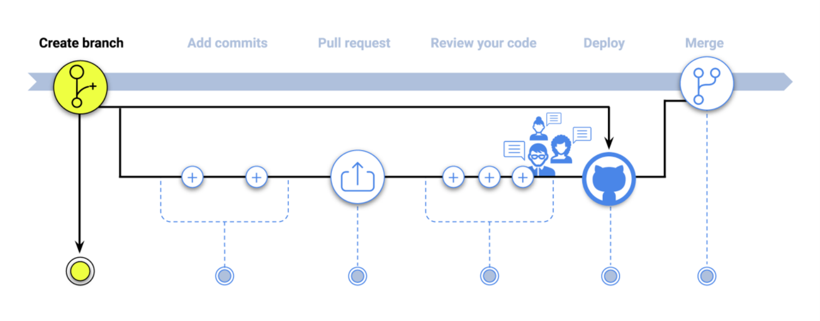
Intro to Git
GitHub Flow: Create a Branch
Notes:
6.1
Step 1: Create a Branch
During your project, you’ll have a few distinct ideas in progress that may or may not be ready to go. Branching was created to manage this workflow. When you add a branch in your project, you’re creating an environment for trying out new ideas. Changes you make on a branch won’t affect the master branch, so you’re free to experiment and commit changes, assured that your branch won’t be merged until it is ready for a collaborator’s review.
There are a few ways you can create new branches in Git. The most common follows:
git checkout -b <branch-name>
The above method is used often because it will create a branch from your current branch and will switch you to that branch in a single command line.
Another common option is to use the branch command directly. Note that this command will not automatically switch over to the newly created branch. However, if you do wish to switch, you can use the checkout command.
In the code below, there are two commands. With the first, a branch is created. The second command will “checkout” the branch, and switch you to it.
git branch <branch-name> git checkout <branch-name>

Slide 37
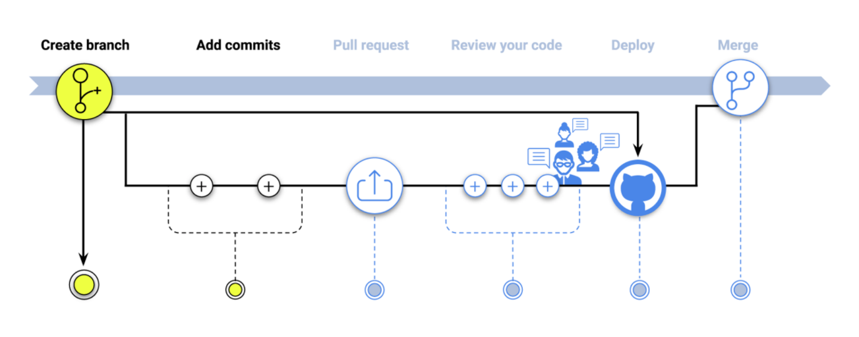
Intro to Git
GitHub Flow: Add Commits
Notes:
6.1
Step 2: Add Commits
Once your branch has been created, you can start making changes. Whenever you add, edit, or delete a file, you’re making a commit and adding them to your branch. This process of adding commits keeps track of your progress as you work on a feature branch. Commits also create a transparent history of your work that others can follow to understand what you’ve done and why. Each commit has an associated commit message, which is a description explaining the reason a particular action was made. Moreover, each commit is considered a separate unit of change. This lets you roll back changes if a bug is found, or if you decide to head in a different direction.
git status git add . git commit -m 'first commit'
Please note, the git add . command will add all paths to the staged changes if they’re either changed or are new and not ignored. To fully grasp the add command, take a few minutes to read the documentation.
Once you’ve committed your changes, the natural next step is to push our branch. Remember, do commit and push early and often—creating periodic checkpoints helps you understand how you broke something.
git push origin <branch-name>

Slide 38
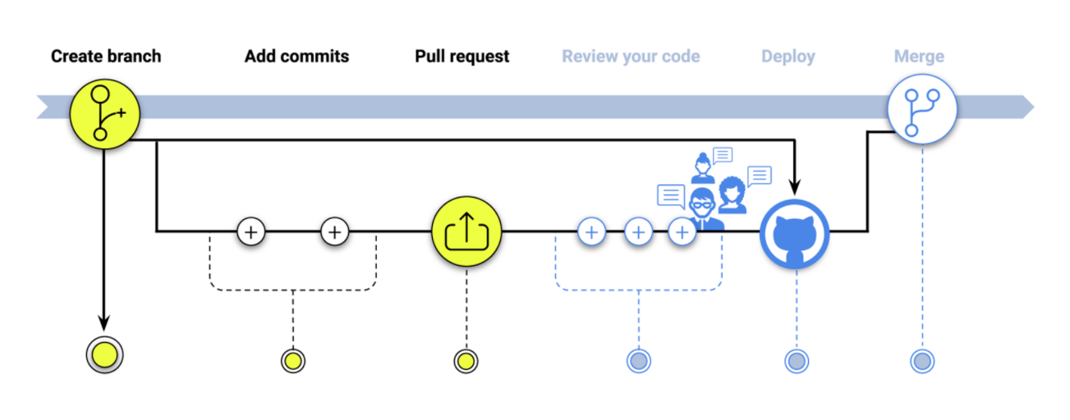
Intro to Git
GitHub Flow: Pull Request
Notes:
6.1
Step 3: Pull Requests
Pull requests initiate discussion about your commits. Since they’re tightly integrated with the underlying Git repository, anyone can see exactly what changes would be merged if they accept your request. Pull requests can be opened at any point during the development process: when you have little or no code but want to share some screenshots or general ideas, when you're stuck and need help or advice, or when you're ready for someone to review your work. Also, pull requests are useful for contributing to open source projects and for managing changes to shared repositories. If you're using a Fork & Pull Model, pull requests provide a way to notify project maintainers about the changes you'd like them to consider. If you're using a Shared Repository Model, pull requests help start a code review and conversation about proposed changes before they're merged into the master branch.
git push origin <branch-name>

Slide 39
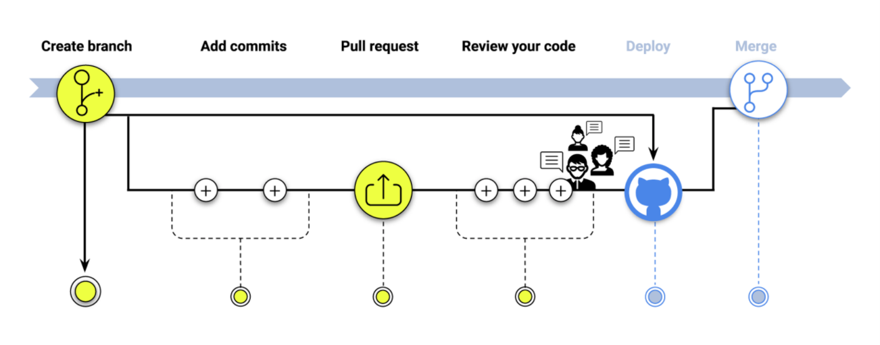
Intro to Git
GitHub Flow: Review your Code
Notes:
6.1
Step 4: Review Your Code
Once a pull request has been opened, the person reviewing your changes might have questions or comments. Perhaps the coding style doesn’t match project guidelines, the change is missing unit tests, or maybe everything looks great and props are in order. Pull requests are designed to encourage and capture this type of conversation. Also, you can continue to push to your branch in light of feedback about your commits. If someone comments that you forgot to do something or if there is a bug in the code, you can make corrections in your branch and push up the change. GitHub will show your new commits and any additional feedback you might receive in the unified pull request view.

Slide 40
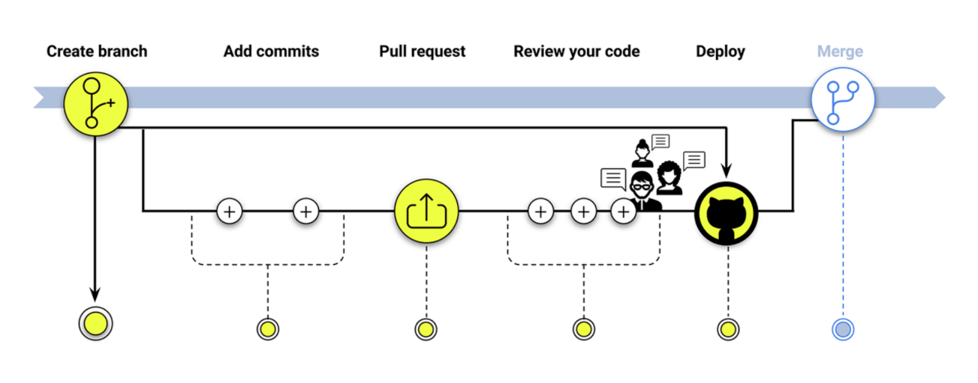
Intro to Git
GitHub Flow: Deploy
Notes:
Step 5: Deploy for Final Testing
With GitHub, you can deploy from a branch for final testing in production before merging to master. Once your pull request has been reviewed and the branch passes your tests, you can deploy your changes to verify them in production. If your branch causes issues, you can roll it back by deploying the existing master into production.

Slide 41
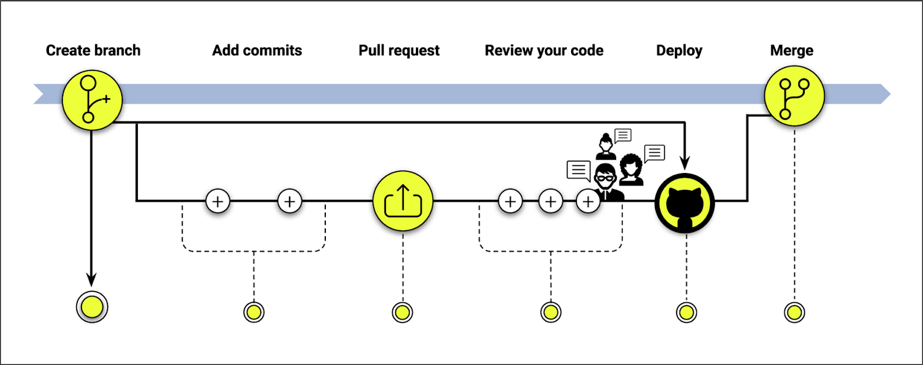
Intro to Git
GitHub Flow: Merge Your Code
Notes:
6.1
Step 6: Merge Your Code
Now that your changes have been verified in production, it is time to merge your code into the master branch. Once merged, pull requests preserve a record of the historical changes to your code. These records are searchable so that anyone can review them easily to understand why and how decision was made.
Before performing a merge, there are a couple of preparation steps to take to ensure the merge is performed smoothly. Open the command line interface, if you have not already, and follow the instructions below:
Execute git status to ensure that HEAD is pointing to the correct merge-receiving branch. If needed, execute git checkout <receiving> to switch to the receiving branch or checkout directly to the merge-receiving branch if you know its name.
Make sure the receiving branch and the merging branch are up to date with the latest remote changes. Execute git fetch to pull the latest remote commits. Once the fetch is complete, ensure the master branch has the latest updates by executing git pull.
Now, a merge can be initiated by executing git merge <branch name>, whereby <branch name> is the name of the branch that will be merged into the receiving branch.
Once the merge is completed, deleting the branch you created is not necessary; however, it is best practice to prune unneeded branches.

Slide 42
Activity: Adding Files from the Command Line
In this activity, we will create a new repository, clone it and add files via command line.
10 Minutes
Notes:
6.2

Slide 43
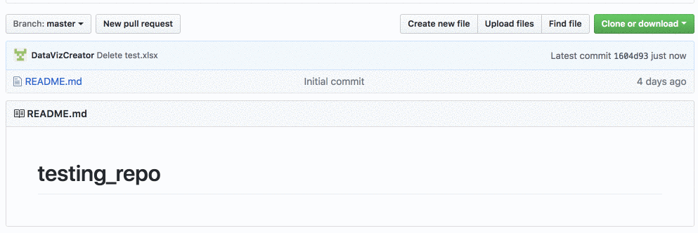
Activity: Adding Files from the Command Line
Instructions:
Create a new repo.
Open terminal (or git-bash for Windows users) and navigate to the home folder using cd ~.
Type in git clone <repository link> in the terminal to clone the repo to the current directory. Once this has run, everyone should now see a folder with the same name as the repo.
Notes:
6.2
Tell students that so far they have only added files using the GitHub website, which works well when just dealing with one or two files. What happens when multiple files need to be quickly added?
The command line comes to the rescue!
Have students follow along with creating a repo and adding files with Terminal/git-bash.
Create a new repo.

Slide 44

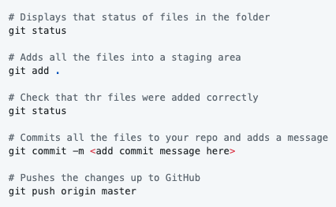
Activity: Adding Files from the Command Line
Instructions:
Open the folder in VS Code and create two python script files named script01.py and script02.py.
Once the files have been created, open up Terminal/git-bash and navigate to the repo folder. Run the following lines and explain each as you go through them.
Notes:
6.2
Once they are done ask the class to navigate to the repo on Github.com to see that the changes have been pushed up.

Slide 45
Activity: Adding Files from the Command Line
GitHub Main Branch:
Historically, the most common name for the main body of a codebase has been master. Recently, however, main has been gaining in popularity. In fact, GitHub now uses main as the default name for its repositories - as do the projects in this course. Be aware that you might see instances of both throughout your development career, or hear experienced coders use the term "master branch" out of habit.
Notes:
6.2
Once they are done ask the class to navigate to the repo on Github.com to see that the changes have been pushed up.

Slide 46
Activity: Adding more to the repo.
In this activity, we will create a new repository, clone it and add files via command line.
10 Minutes
Notes:
6.3

Slide 47
Activity: Adding more to the repo
Instructions:
Using the repo that just created, make or add the following changes:
Add new lines of code to one of the python files.
Create a new folder.
Add a file to the newly created folder.
Add, commit and push the changes.
Delete the new folder.
Add, commit and push the changes again.
Notes:
6.3

Slide 48
Notes:
6.4
Check lesson plan to review or see below
3-Hour Adjustment: This review activity is now an Everyone Do.
Spend only 15 minutes on this activity.
Use the review section as guidance for talking points as you live-code along with the students.
Be sure to take your time and answer all student questions along the way.
Ask students for any questions students may have and take a few minutes to review any commands which weren't clear. Offer to help students with this throughout the day and during office hours.
Explain to students that this will be the new, primary way of submitting homework to GitHub (no more manual uploads!).
Reassure them that it's ok if this take some time to figure out. By the end of the course, they will be git ninjas!
Encourage students to continue to add and commit their activities today into a repo for additional practice.

Slide 49

last
but
not least..
Notes:
Note: This is slide combines lesson 7.1 AND 7.2
Leave this slide running while you run WHOLE lesson 7
Before finishing up for the night, slack out the Video Guide containing walkthroughs of this week's key activities. Encourage students to review them later and utilize office hours if they have further questions.
✏️ 7.2 Extra Do: Additional Activities
If class finishes ahead of schedule, or during office hours, let students know that there are some additional challenging exercises to work for those that are ready. For students that still have question there will be time to get additional help from TA's and the instructor.
Supplemental exercises:
Slack these out in case they need it!
ADVANCED_Ins_Set_Operations
ADVANCED_Stu_Resume_Analysis
ADVANCED_Stu_UUID_Generator
Stu_Email

